Slide 1
DIFFERENCES
HARVARD ARCHITECTURE
VON NEUMANN ARCHITECTURE
It is ancient computer architecture based on stored program computer concept.
Same physical memory address is used for instructions and data.
There is common bus for data and instruction transfer.
Two clock cycles are required to execute single instruction.
CPU can not access instructions and read/write at the same time.
It is modern computer architecture based on Harvard Mark I relay based model.
Separate physical memory address is used for instructions and data.
Separate buses are used for transferring data and instruction.
An instruction is executed in a single cycle.
CPU can access instructions and read/write at the same time

Slide 2
DIFFERENCE
VON NEWMANN ARCHITECTURE
HARVARD ARCHITECTURE
It is cheaper in cost.
It is used in personal computers and small computers.
The speed of execution of the Von Neumann Architecture is comparatively slower. It is because it is not capable of fetching the instructions and data both at the same time.
This architecture basically requires less space.
It is costly than Von Neumann Architecture.
It is used in micro controllers and signal processing.
The overall speed of execution of Harvard Architecture is comparatively faster. It is because the processor, in this case, is capable of fetching both instructions and data at the very same time.
This architecture comparatively requires less space.

Slide 3
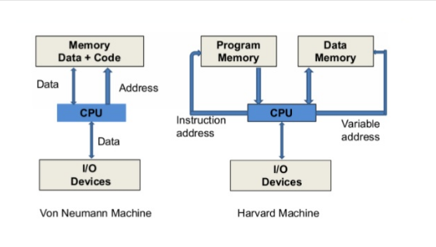
DIFFERENCES

